Slide 1
System Level Tests
Theodore Hancock

Slide 2
What is System Testing?
“System Testing is the testing of a complete and fully integrated software product. Usually, software is only one element of a larger computer-based system. Ultimately, software is interfaced with other software/hardware systems. System Testing is actually a series of different tests whose sole purpose is to exercise the full computer-based system.”

Slide 3
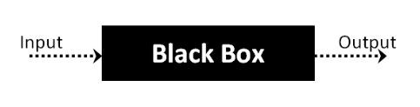
Black Box Testing
black box testing: testing technique in which functionality of the Application Under Test (AUT) is tested without looking at the internal code structure, implementation details and knowledge of internal paths of the software. This type of testing is based entirely on software requirements and specifications.
Notes:
With black box testing you are focusing only on the input and the output of the program and aren’t worried about the actual code that runs the program

Slide 4
Basic steps for Black Box Testing
Here are the generic steps followed to carry out any type of Black Box Testing.
Initially, the requirements and specifications of the system are examined.
Tester chooses valid inputs (positive test scenario) to check whether SUT (system under tests) processes them correctly. Also, some invalid inputs (negative test scenario) are chosen to verify that the SUT is able to detect them.
Tester determines expected outputs for all those inputs.
Software tester constructs test cases with the selected inputs.
The test cases are executed.
Software tester compares the actual outputs with the expected outputs.
Defects if any are fixed and re-tested.

Slide 5
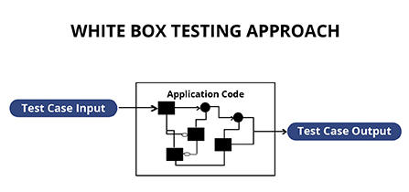
White box testing
White box testing is the testing of the internal workings or code of a software application. During this test you should be looking for the following:
Internal security holes
Broken or poorly structured paths in the coding processes
The flow of specific inputs through the code
Expected output
The functionality of conditional loops
Testing of each statement, object, and function on an individual basis

Slide 6
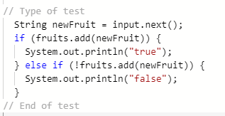
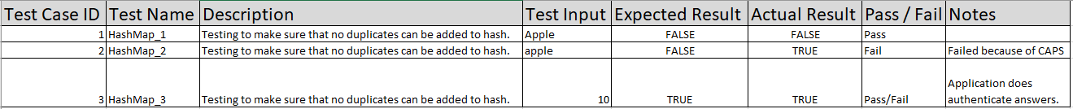
Simple Example
https://repl.it/@BlakeHancock/System-Tests-Fruit-add
The following will test to see if items added to HashMap return true or false.

Slide 7

Sources
https://www.softwaretestinghelp.com/system-testing/
https://www.guru99.com/system-testing.html
https://www.guru99.com/black-box-testing.html

